Slide 1
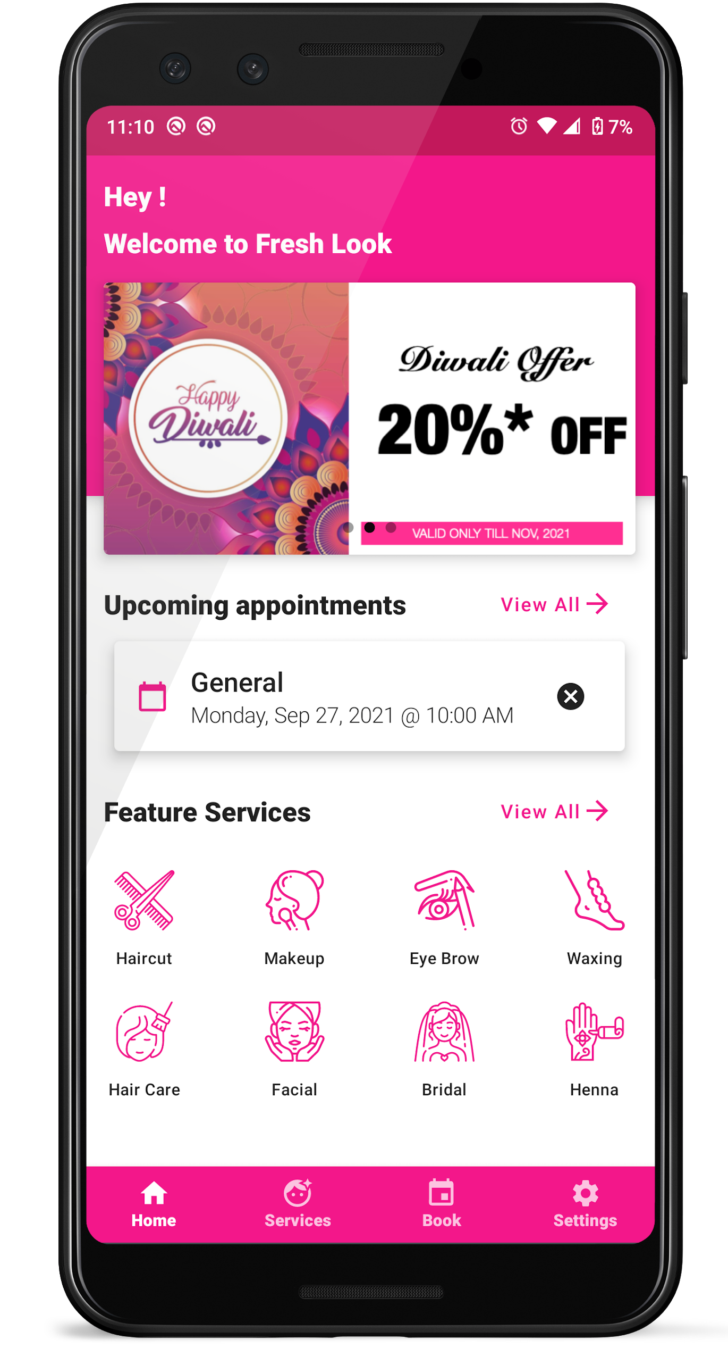
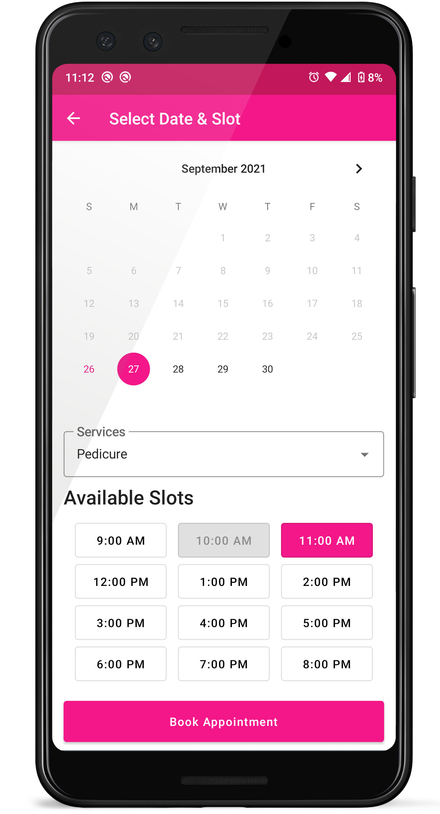
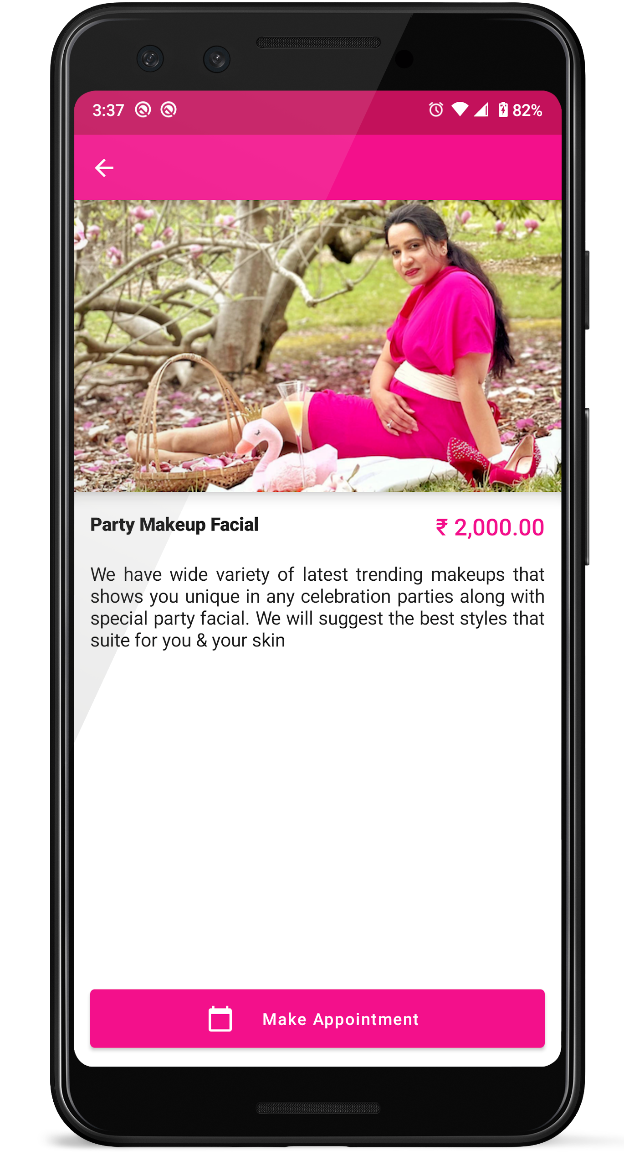

INTUITIVE DESIGN
Elegant Dashboard
Offers!
Appointments!
Information!
We Care
Yours Skin
Fresh Look
Beauty Parlor

Slide 2

P0p0 ,’/]≥
Offers!
Appointments!
Tips!
We Care
Yours Skin
Fresh Look
Beauty Parlor
_{No 39/A, New Street,}
Arakkonam - Ocheri Rd,Nagavedu, Arakkonam, Tamil Nadu 631002
_{Customer Care:}
₊₉₁ ₍₈₂₂₎₋₀₀₆₋₁₀₀₁
₊₉₁ ₍₈₀₉₎₋₈₈₈₋₉₄₉₄
_{freshlookdesk@gmail.com}

